Slide 1

Hello!
I am William Ignatius Wijaya
DIGHUM 100 Course Info:
https://classes.berkeley.edu/content/2021-summer-dighum-100-001-wbl-001
Notes:
Hello, my name is William Ignatius Wijaya.

Slide 2
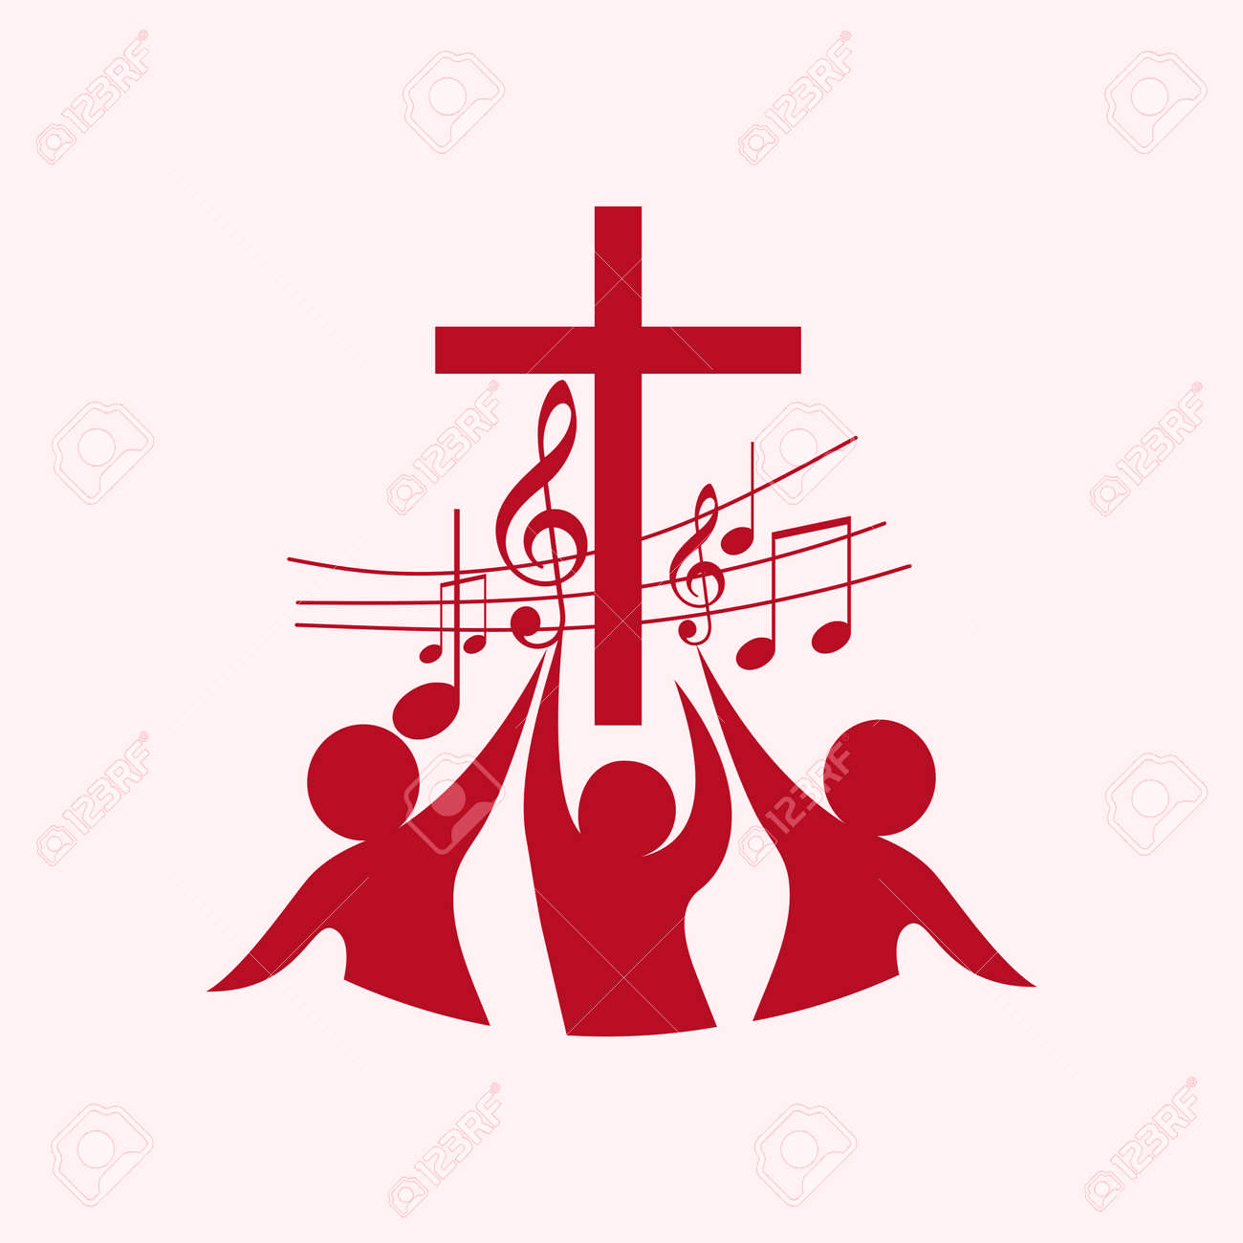
Christian Music-
Analytical Comparison between CTM and CCM
Notes:
Today I will be presenting my project about analytical comparison between CTM and CCM.

Slide 3
History of Christian Music
Christian Traditional Music (CTM)
Early 17th century
“Gospel song”
Hymns and sacred song
Christian Contemporary Music (CCM)
Late 1960s
“Jesus Movement”
Praise and Worship
Related to pop rock
Notes:
Christian Music has a very interesting history in it. From being rejected in society, and now accepted by a lot of people.
For this project, I want to compare CTM and CCM using the tools and methods in data science. This is the slide showing the differences between CTM and CCM.
Before going into the project, I want to introduce to you the difference between Chiristian Traditional Music and Christian Contemporary Music. Christian Traditional Music or CTM can be traced by early 17th century. Christian Traditional Music is usually called Gospel Song. Gospel song is a song that focuses on using hymns and has a sacred characteristic in it. On the other hand, Christian Contemporary Music or CCM is popular on the late 1960s. This era is usually called “Jesus Movement”. CCM is usually used on praise and worship sessions in church. The genre of CCM is strongly related to pop rock.

Slide 4
1.Are top rated songs unique? Or are they similar to each other?
EDA Questions
2. What kind of emotions when people listen to CTM and CCM?
3. How is the word choice between CTM and CCM differs?
4. How CTM and CCM differs in term of their audio components?
Notes:
These are my research questions. (enter) This the first question, (enter) second question, (enter) third question, and (enter) the last question

Slide 5
Hypothesis
All documents are unique, different messages with the same purpose
Emotions: Joy, positive, and trust
CTM: word from past, CCM: word from now
CTM: ‘about’ God. CCM: ‘to’ God
CTM: musical style of past, CCM: pop
Notes:
My hypothesis is that all documents are unique because each top rated songs have different messages given that they have the same purpose. The emotions that people have are joy, positive, and trust. CTM tends to use words from the past and describing about God, while CCM tends to use words from now and use words that are to God. Finally, CTM have musical element of the past, while CCM have musical elements toward pop music.

Slide 6





Description of Dataset
Notes:
Now, I will describe my dataset. First, I will be pulling out the lyrics from either Genius API or musixmatch API. I search the lyrics by typing the title and the artist of each song manually into my notebook and proceed into searching the lyrics. Other than that, I am getting the audio features of each song using Spotify API by searching the tracking id of each song manually. Then, I proceed into constructing the dataframe using pandas and do data cleaning by removing unnecessary words in the lyrics using NLTK package in phyton.

Slide 7
Cosine Similarity Analysis
1. Are top rated songs unique? Or are they similar to each other?
Notes:
First, I will be doing cosine similarity analysis to answer question number 1.

Slide 8
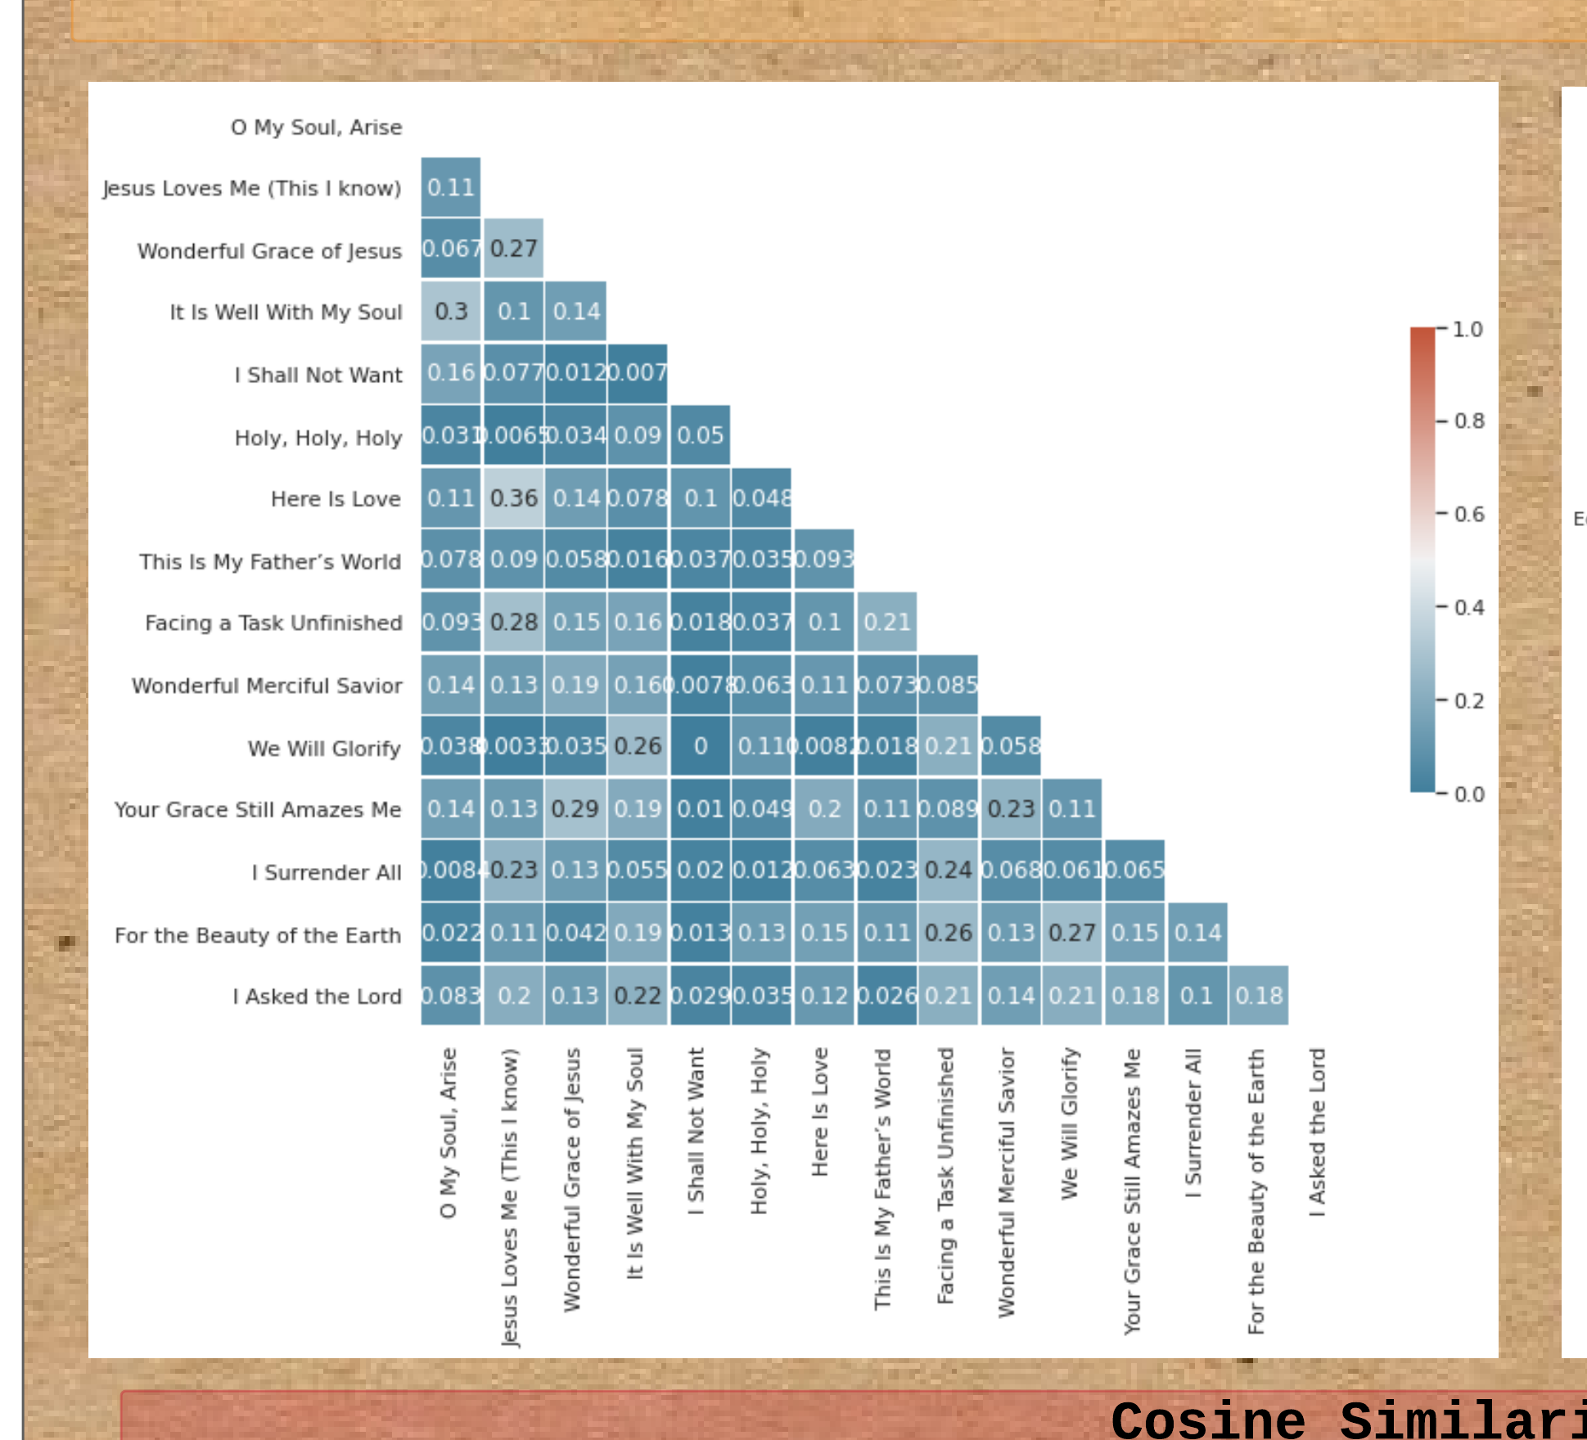
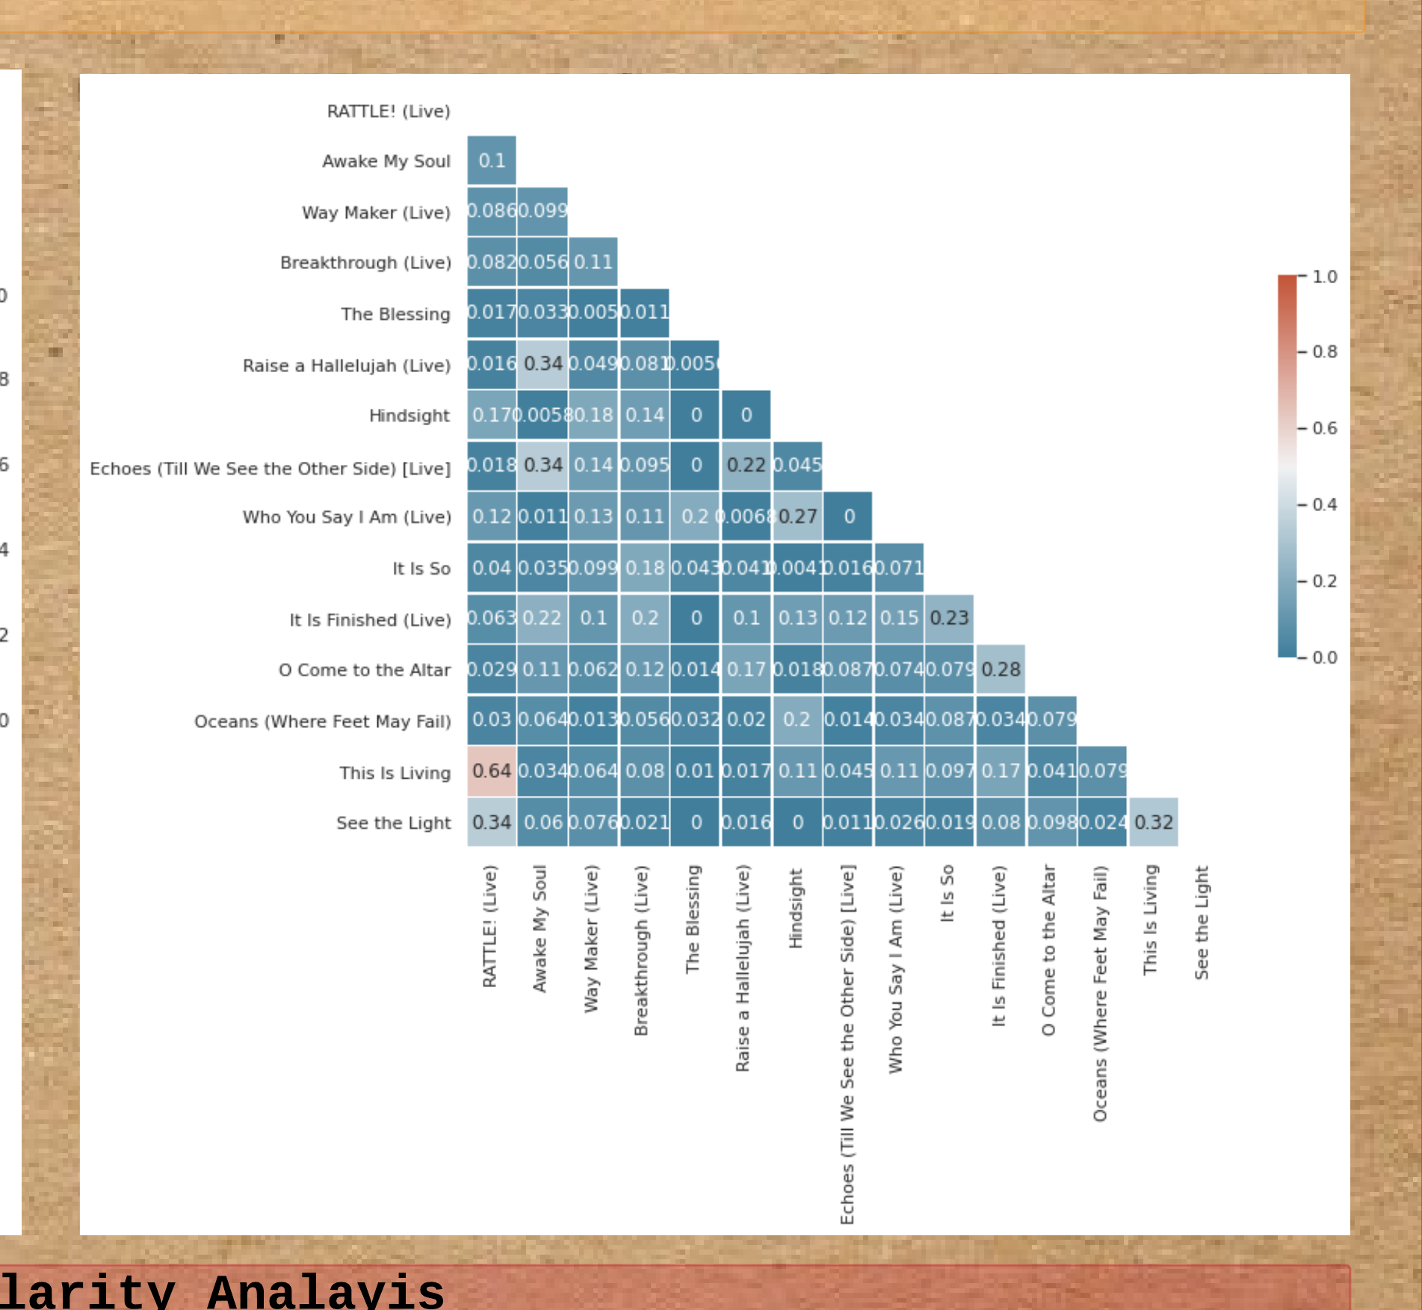
Notes:
(enter) The left part is the graph for CTM and (enter) the right part is the graph for CCM. Both graphs suggest that the top rated songs are unique because of the low correlation between each song.

Slide 9
Sentiment analysis
2. What kind of emotions when people listen to CTM and CCM?
Notes:
I proceed into doing sentiment analysis to answer question number 2.

Slide 10
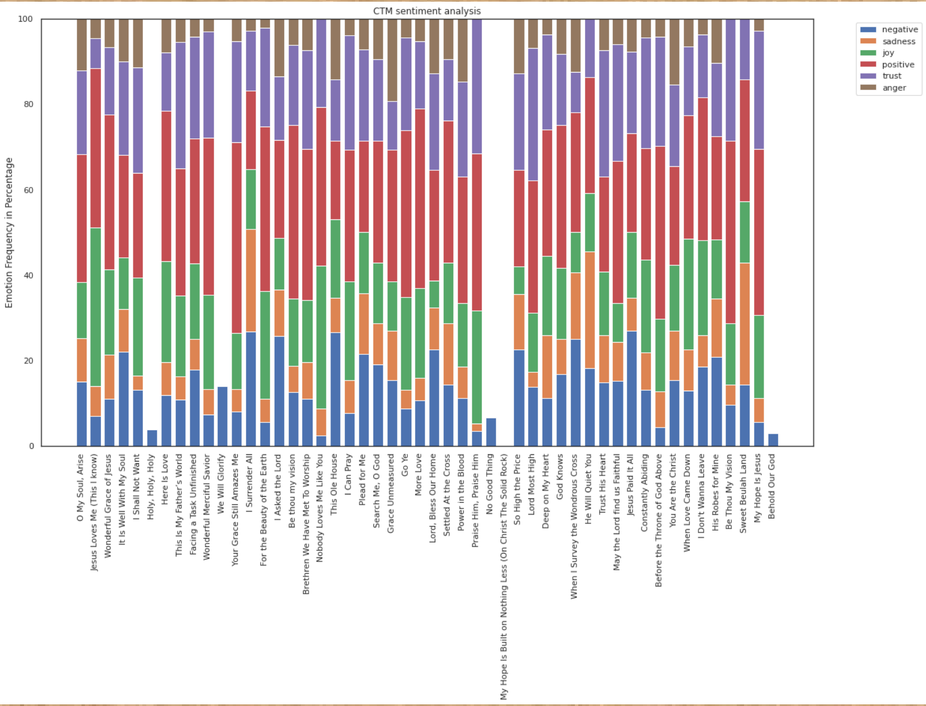
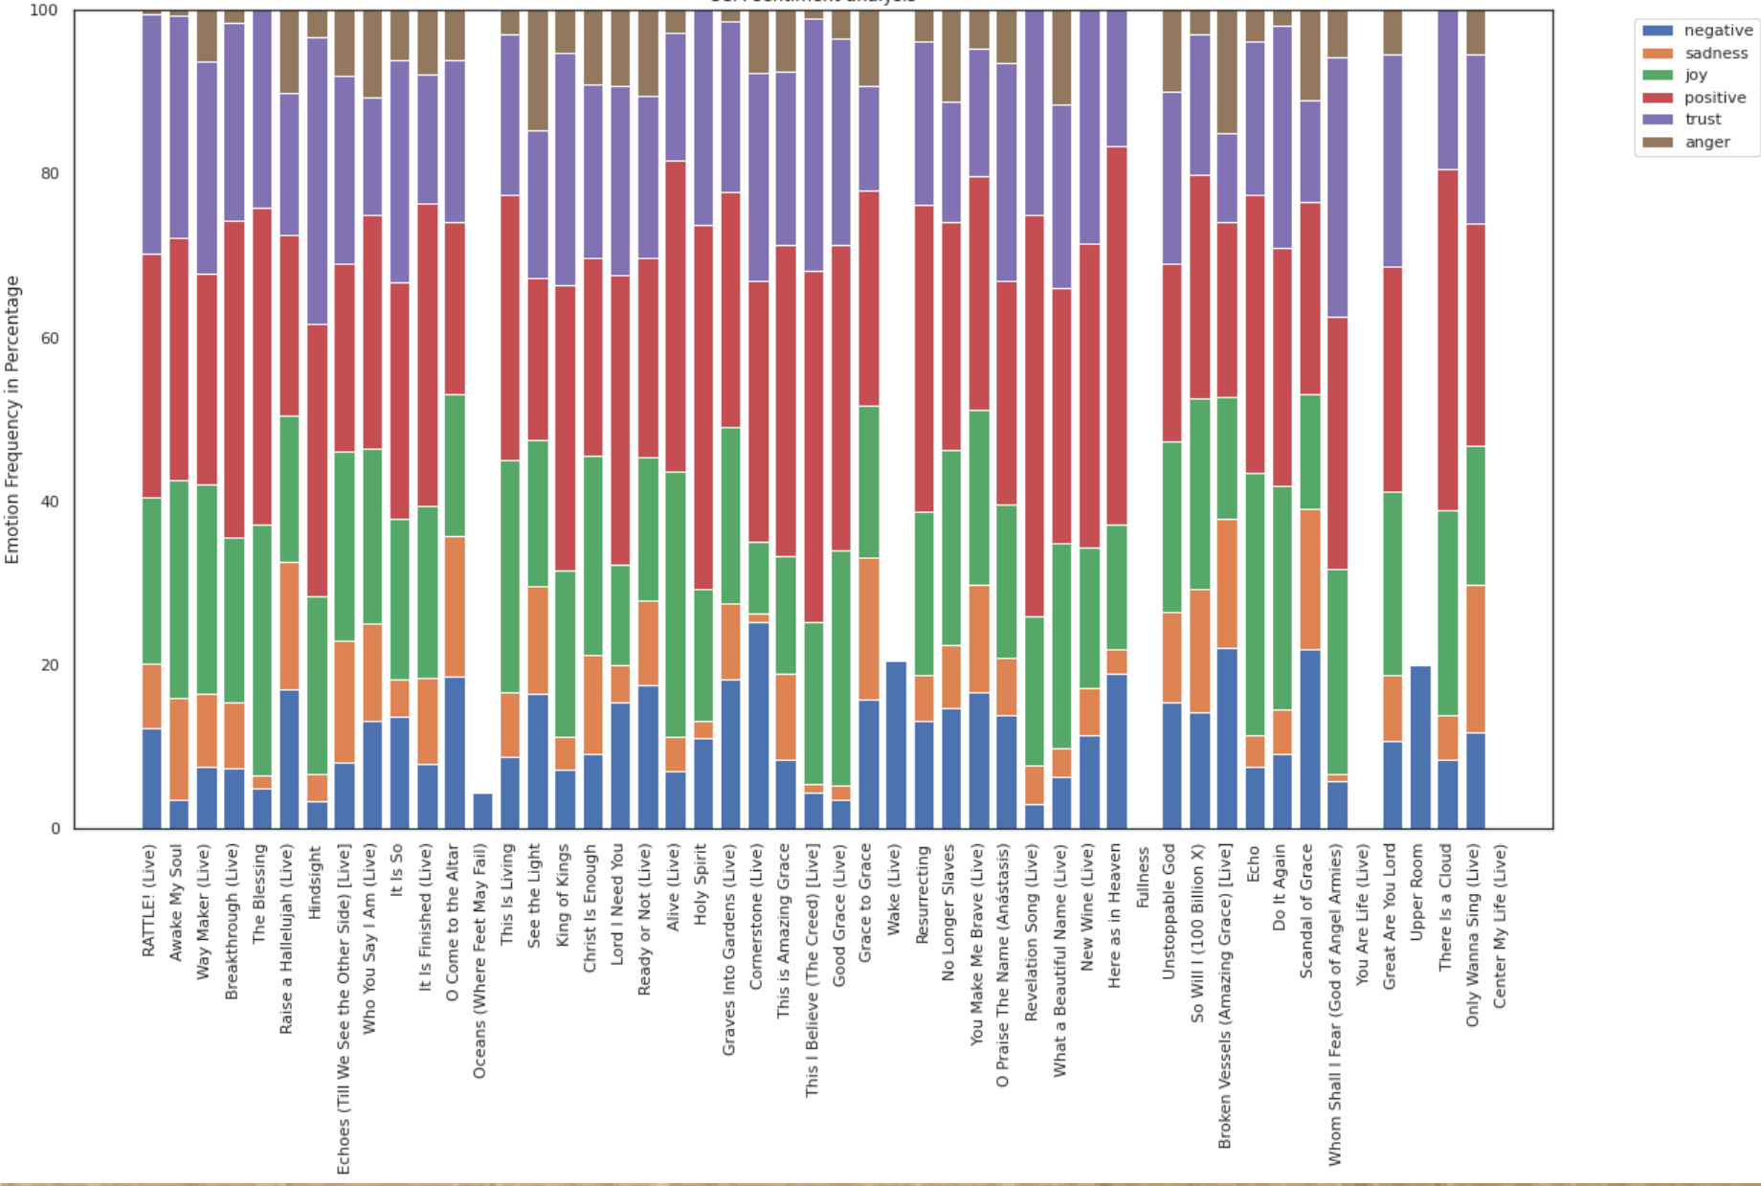
Notes:
(enter) This is the graph for CTM sentiment analysis (enter) and (enter) this is the graph for CCM sentiment analysis. We can see that positive emotions exceeds negative emotions, joy exceeds sadness, and trust exceeds anger. This suggests that people experience more toward positive, joy, and trust when listening to both CTM and CCM music, which is in accordance to my hypothesis.

Slide 11
Worldcloud analysis
3. How is the word choice between CTM and CCM differs?
Notes:
Then, I will be using worldcloud analysis to answer question 3.

Slide 12
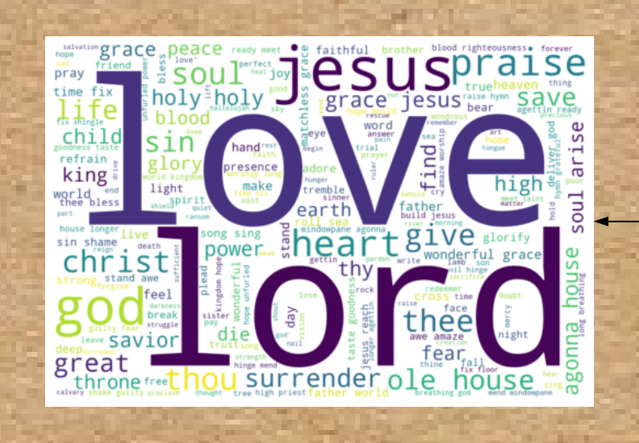
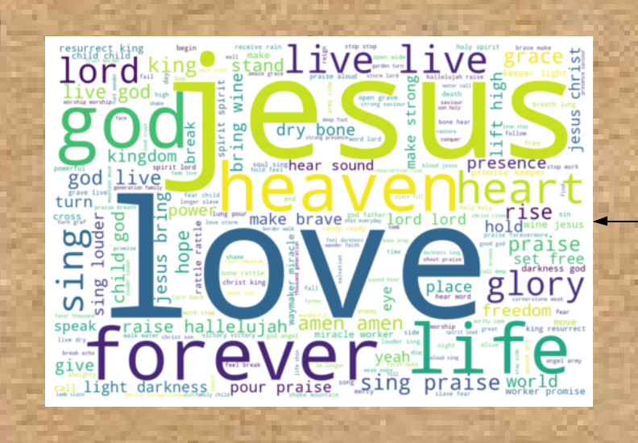
Notes:
(enter) From the CTM worldcloud, CTM songs tends to use words from the past like thee, thou, lord, and so on. And, CTM songs tends to use words that described the attribute and activities God: "thou", "great", "thee", "holy", and so on. (enter) On the other hand, (enter) CCM songs tends to use words from now like forever, life, live, glory, etc (et cetera). CCM focus less on the word of the song and more on the sense of union in the hearing and singing together, like: "glory", "sing", "jesus" (more frequent compared to CTM), "hallelujah", and so on.
Other than that, all the words from the both of the worldclouds seem to promote positivity, joy, and trust, which further supports the conclusion from the sentiment analysis.

Slide 13
Audio component analysis
4. How CTM and CCM differs in term of their audio components?
Notes:
Lastly, I will be doing audio component analysis to answer question 4

Slide 14
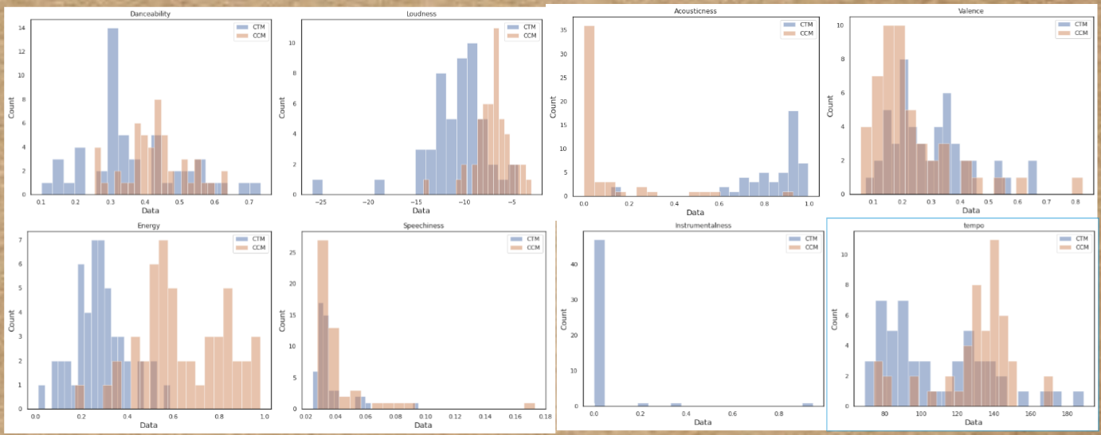
Notes:
These are the histograms for each of the audio features.

Slide 15
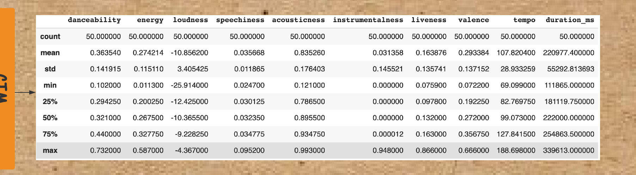
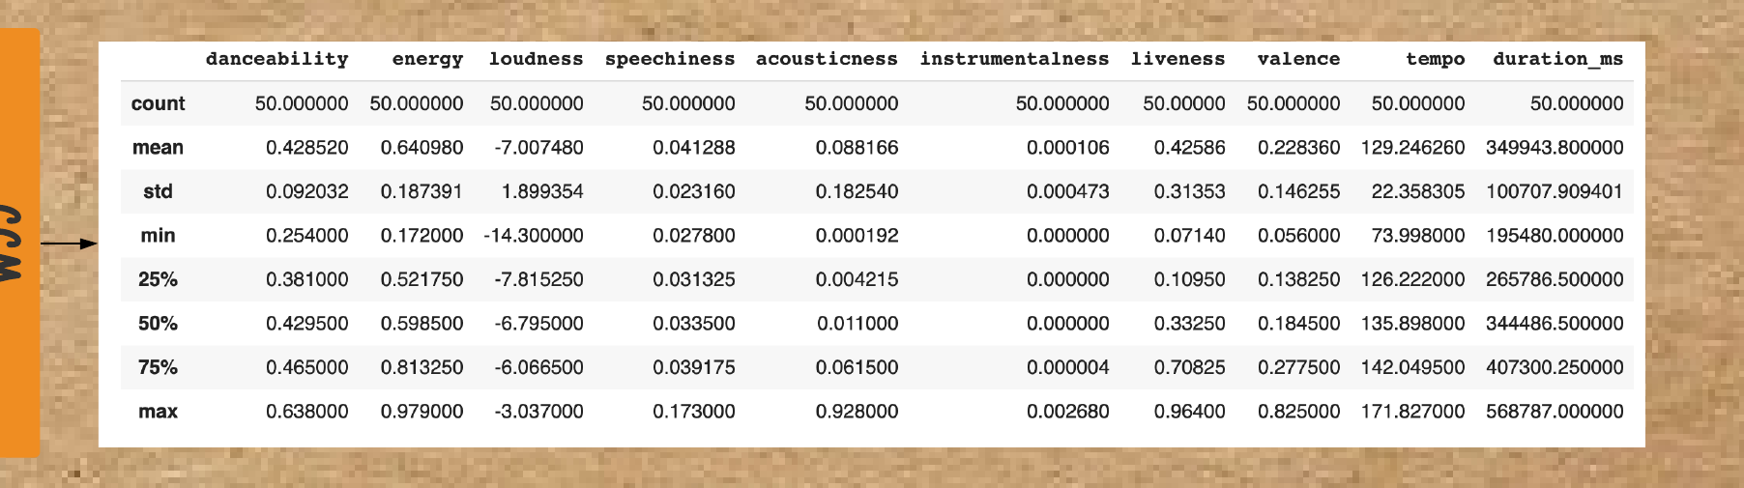
Notes:
These are the statistic table. The upper part for CTM and the bottom is for CCM.

Slide 16
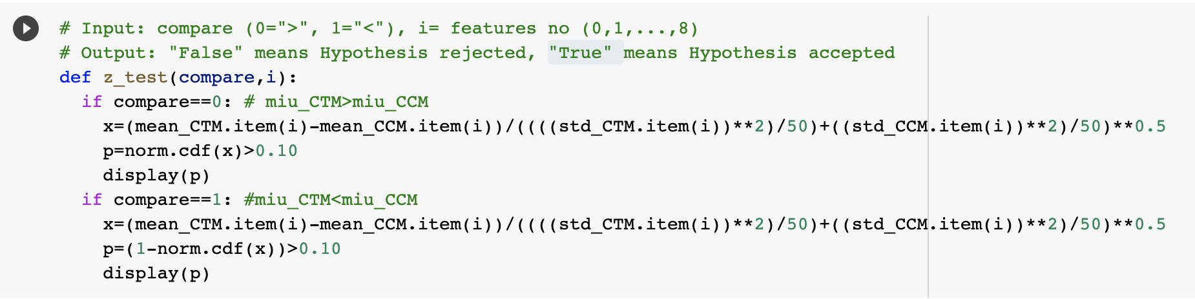
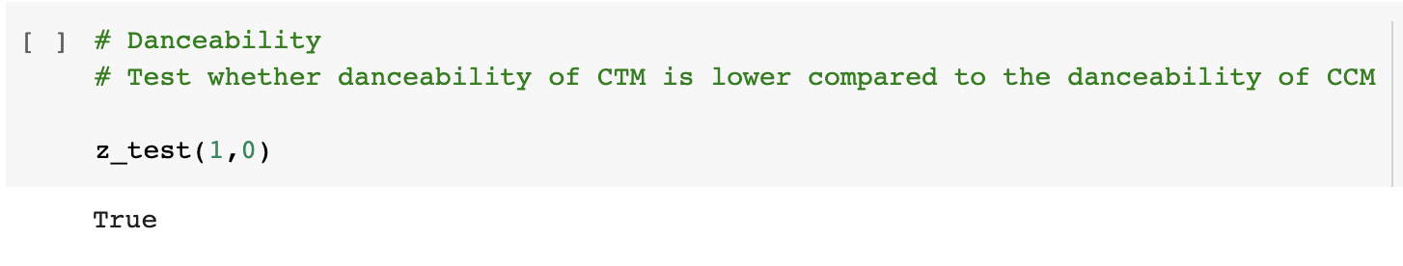
Notes:
And this is the z-test function.

Slide 17
Result
Danceability: CTM is lower than CCM
Energy: CTM is lower than CCM
Loudness: CTM is lower than CCM
Speechiness: CTM is lower than CCM
Acousticness: CTM is higher than CCM
Instrumentalness: CTM is higher than CCM
Liveness: CTM is lower than CCM
Valence: CTM is higher than CCM
Tempo: CTM is lower than CCM
Notes:
These are the conclusions I made using the histogram, statistic table, and z-test. We can see that CTM songs tends to use more acoustic instrument and have audio features more toward the musical elements of the past. On the other hand, CCM songs tends to be more energetic, loud, more beat, and more words in it, which matches more toward pop music

Slide 18

1.Are top rated songs unique? Or are they similar to each other?
EDA Questions
2. What kind of emotions when people listen to CTM and CCM?
3. How is the word choice between CTM and CCM differs?
4. How CTM and CCM differs in term of their audio components?
Notes:
Overall, (enter) all my EDA questions are answered using the tools and methods I described.

Slide 19
Acknowledgements
Notes:
I would like to thank Dr Adam Anderson for teaching us this course and Ash Tan for providing us with the tools and methods to make this project possible.

Slide 20
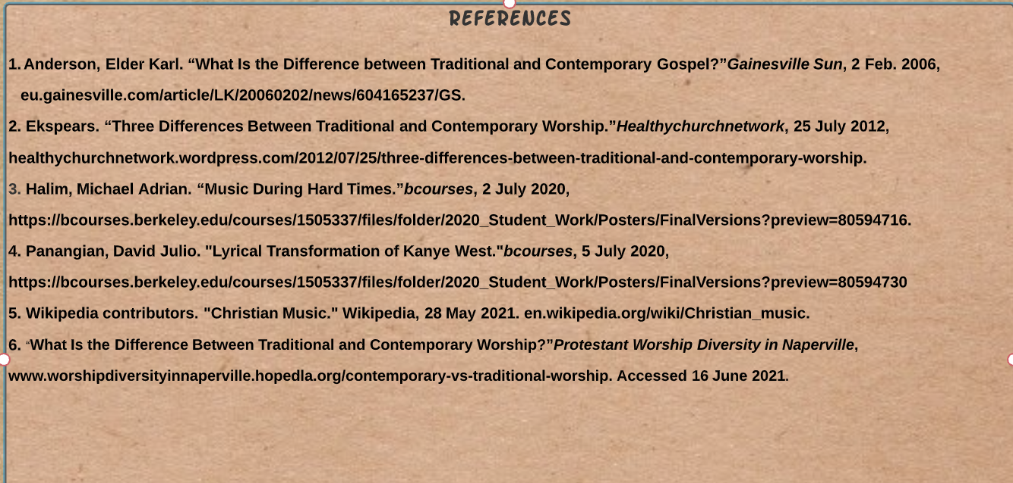
Works Cited
Notes:
For the works cited, this is the first page

Slide 21
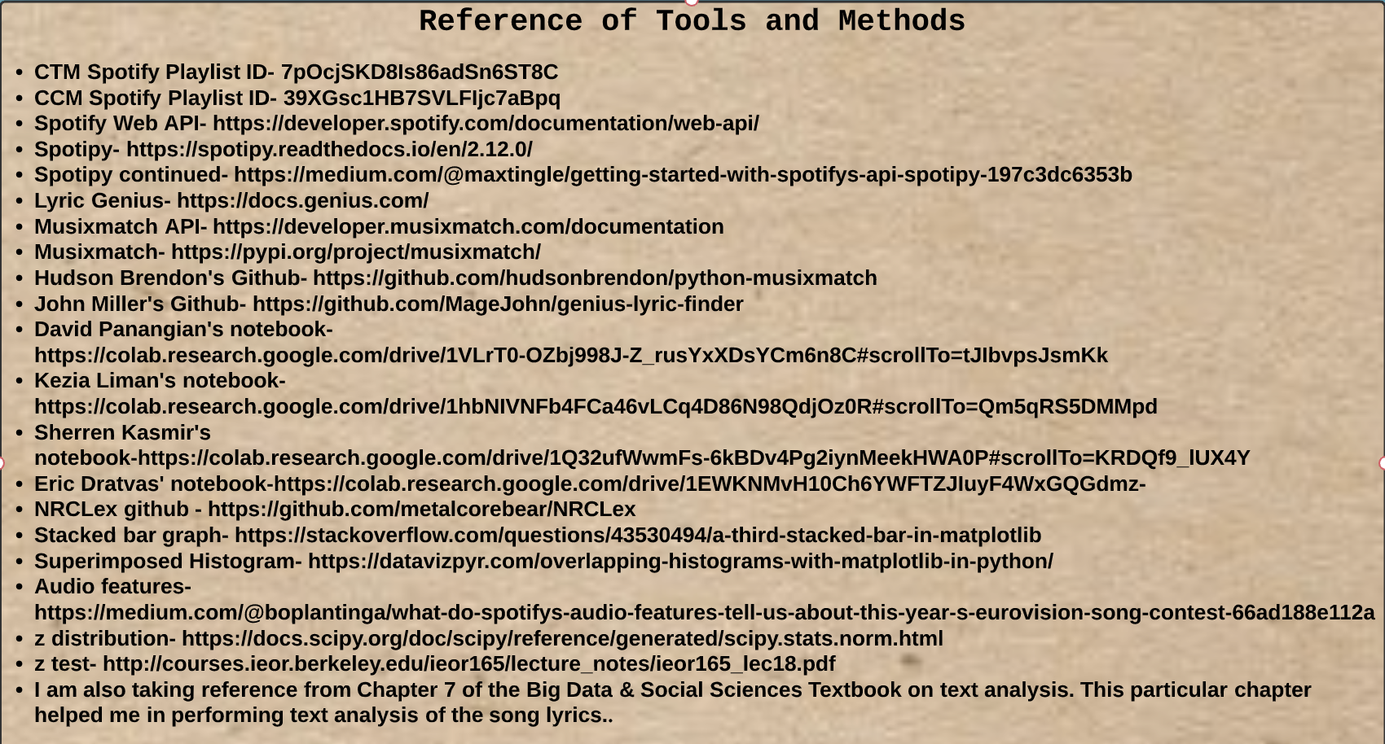
Works Cited
Notes:
And, this is the second page.

Slide 22
Links
Notebook-
https://colab.research.google.com/drive/1Ud11ow7BxNaXwDpHFlISSj_-5szpTWgW?usp=sharing
Poster-
https://drive.google.com/file/d/1X4PAT8CbUunflkZTg_GL2zogomUDX5ev/view?usp=sharing
Github repo-
https://github.com/iw30/DH100-project
Notes:
This is the link for my notebook, poster, and github repository

Slide 23
Thank you
Notes:
Thank you for listening to my presentation. And I hope that you have a great day.

